Slide 1



punjab

Slide 2


An Open
Source
Community
in Punjab
PRESENTS

Slide 3

Tech for Democracy
Open Source and Surveillance

Slide 4


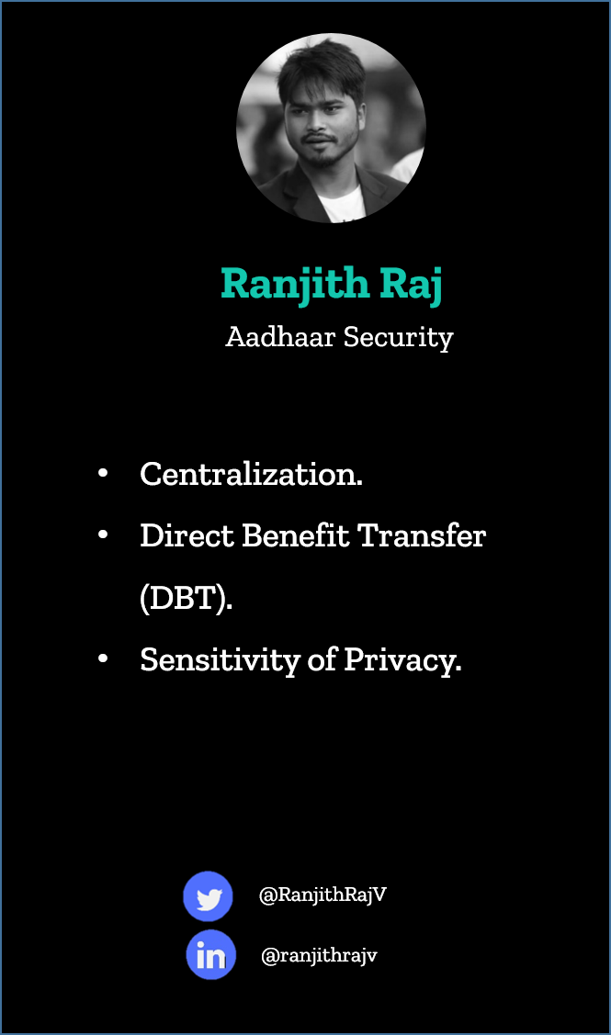

Slide 5



LEARN.
IMAGINE.
EXPLORE.

Slide 6

1
punjab

Slide 7
2
punjab

Slide 8
3
punjab

Slide 9
6
punjab

Slide 10
7
punjab

Slide 11
10
punjab

Slide 12
12
punjab

Slide 13
14
punjab

Slide 14
15
punjab

Slide 15
17
punjab

Slide 16
19
punjab

Slide 17
20
punjab

Slide 18
21
punjab

Slide 19
22
punjab

Slide 20
23
punjab

Slide 21
Feb 2019
23
punjab

Slide 22




23
Time: 9:00am – 4:30pm
Venue: Lovely professional University,
Jalandhar (Block-14-101L)
Feb 2019
Register Here:
https://tinyurl.com/mozilla23feb
@company/mozpunjab
#TechforDemocracy
@MozillaPunjab
#TechforDemocracy
@MozPunjab
#TechforDemocracy

